Slide 1
Multi-Objective Optimization
Alberto TONDA, Senior Researcher (DR)
UMR 518 MIA-PS (Applied Mathematics and Computer Science) INRAE, AgroParisTech, Université Paris-Saclay Institut des Systèmes Complexes, Paris-Ile-de-France

Slide 2
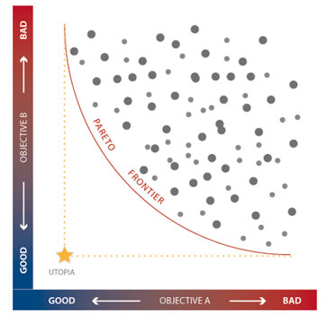
Outline
Multi-objective problems
Multi-objective optimization
Real-world examples
NSGA-II
Other approaches
Many-objective optimization…?

Slide 3
Multi-objective problems
Airplane tickets
Flight duration (h)
UTOPIA
Ticket price (€)

Slide 4
Multi-objective problems
Airplane tickets
Flight duration (h)
Ticket price (€)

Slide 5
Multi-objective problems
Airplane tickets
Flight duration (h)
I and J are non-comparable,
we can’t tell which one is best
I
J
Ticket price (€)
Notes:
Here ask: “which one is best”?

Slide 6
Multi-objective problems
Airplane tickets
Flight duration (h)
I dominates all this points (called Pareto-dominance)
I
Ticket price (€)
Notes:
Here ask: are there any points that you can see that are clearly WORSE than I?

Slide 7
Multi-objective problems
Airplane tickets
Flight duration (h)
J dominates all these other points (Pareto-dominance)
J
Ticket price (€)
Notes:
Here ask: are there any points that you can see that are clearly WORSE than I?

Slide 8
Multi-objective problems
Airplane tickets
Flight duration (h)
I
J
Ticket price (€)
Notes:
Here ask: are there any points that you can see that are clearly WORSE than I?

Slide 9
Multi-objective problems
Airplane tickets
Flight duration (h)
PARETO FRONT
Can we find the set of points that are not dominated?
Ticket price (€)
Notes:
Sometimes also called “Pareto Frontier”

Slide 10
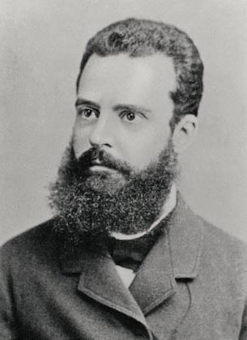
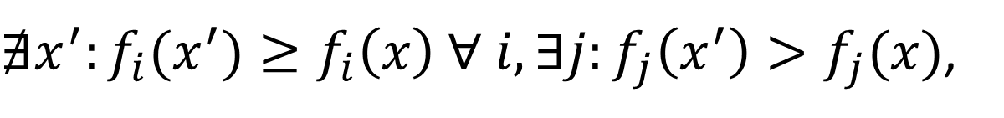
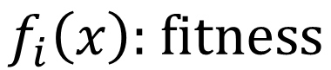
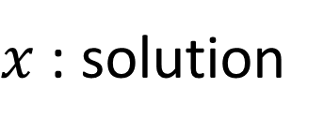
Multi-objective problems
Pareto-optimality
Pareto for minimizing or maximizing
$x$ : solution
$$f_{i}\left(x\right)\text{: }\text{fitness}$$
${{∄x^{′}:f}_{i}(x}^{′})≥f_{i}\left(x\right) ∀ i, ∃j:f_{j}\left(x^{′}\right)>f_{j}(x)$,
Notes:
Most people use this picture of Pareto, but I like this one more, because in the last part of his life he decided he wanted A MASSIVE BEARD, and just went with it.

Slide 11
Multi-objective problems
Real-world problems are often MO
Often with A LOT of conflicting objectives
Plane tickets: seat position, airline, airport…
Production: energy, quality, price, …
Distribution: speed, cost, employment, …

Slide 12
Multi-objective optimization
Single-objective optimization
Find ONE best solution
Multi-objective optimization
Find THE PARETO FRONT (hard, maybe impossible)
Find as many non-dominated points as possible
Finding one point on the Pareto front is easy…
…but finding many is not!

Slide 13
Multi-objective optimization
Techniques to deal with MO
Assign weights to objectives, adjust weights
Some only work on (differential) equations
Multi-objective EAs (state-of-the-art)
EAs are particularly suited
Population of solutions -> lots of points!
Black-box optimization -> easy to adopt!

Slide 14
Multi-objective optimization
MOEAs (general idea)
Create population, evaluate
Create offspring
Find Pareto front
Remove individuals in Pareto front
Recompute Pareto front (iterate)
Obtain list of fronts
Kill individuals starting from worst fronts
Notes:
Now, when dealing with MO problems, the issue of evolutionary algorithms is: how do we choose who lives and who dies?

Slide 15
Multi-objective optimization
Airplane tickets
Flight duration (h)
Ticket price (€)
Notes:
Sometimes also called “Pareto Frontier”

Slide 16

Example: Influence in social networks
Advertise products in social networks
Use influencers (lots of followers)
How to choose influencers? (following overlap)
Spend as little as possible
Multi-objective problem
Minimize influencers
Maximize influence

Slide 17
Example: Influence in social networks
Genome (candidate solution)
Set of nodes taken from a graph
Vector of integers of different size
String of bits (1=influencer, 0=not)
Fitness function
(Max) influence spread in the network
(Min) number of nodes/influencers

Slide 18
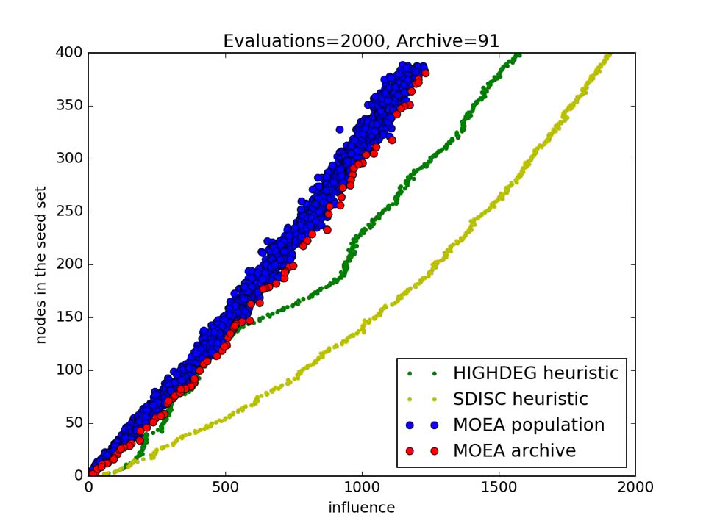

Slide 19
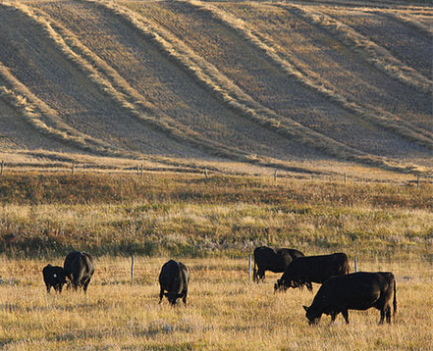
Example: Ecosystem services
Optimize land use in agricultural regions
Percentage of land assigned to each use
Animal feed, crops, forests (carbon sequestration)
Multi-objective problem
Maximize animal energy production
Maximize crop production
Maximize carbon sequestration

Slide 20
Example: Ecosystem services
Genome (candidate solution)
Percentage of land assigned to each task
For each region! (~1500 variables for “massive central”)
Fitness function
Model for animal energy production
Model for crop production
Model for carbon sequestration

Slide 21
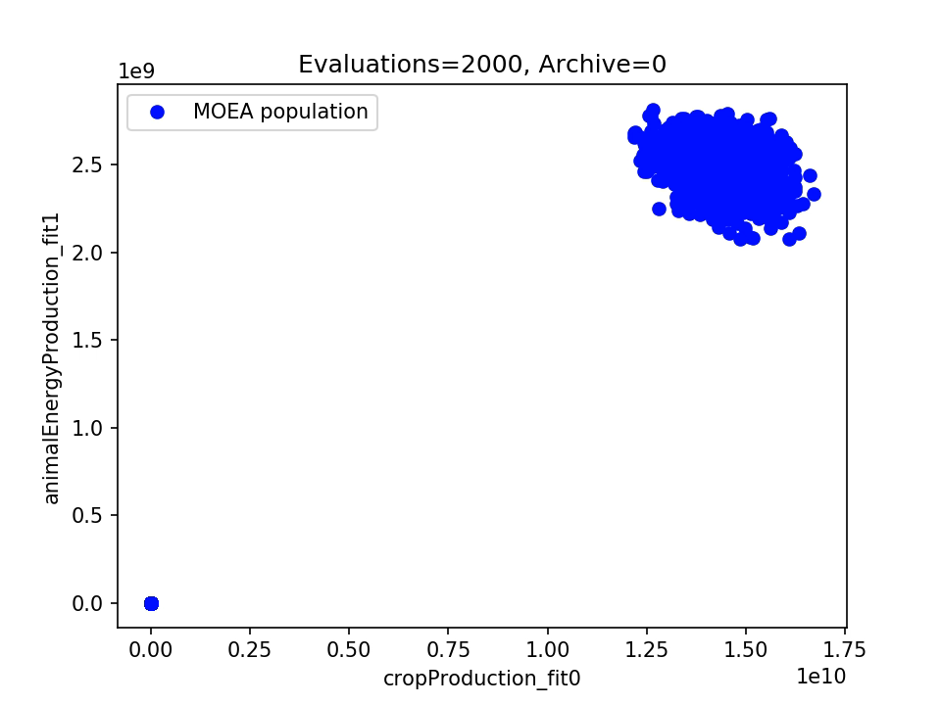

Slide 22
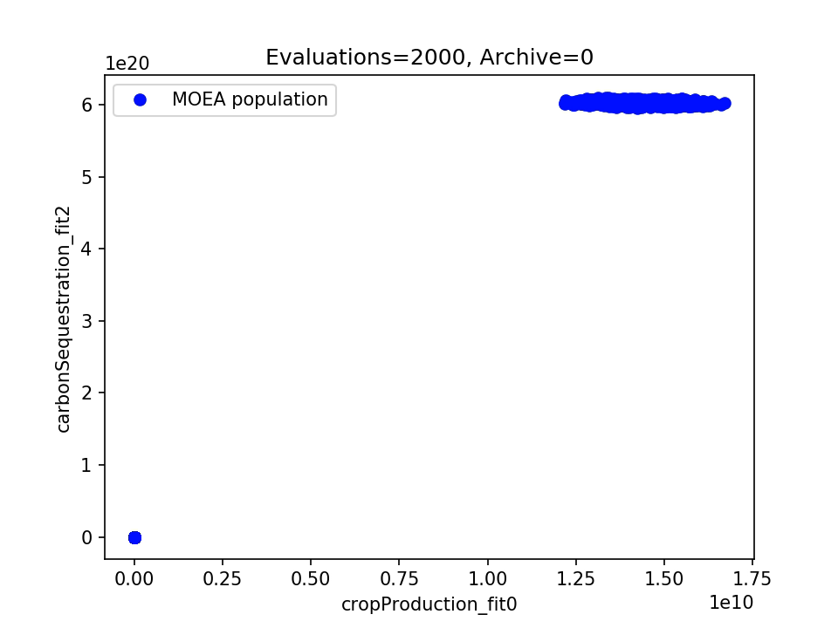

Slide 23
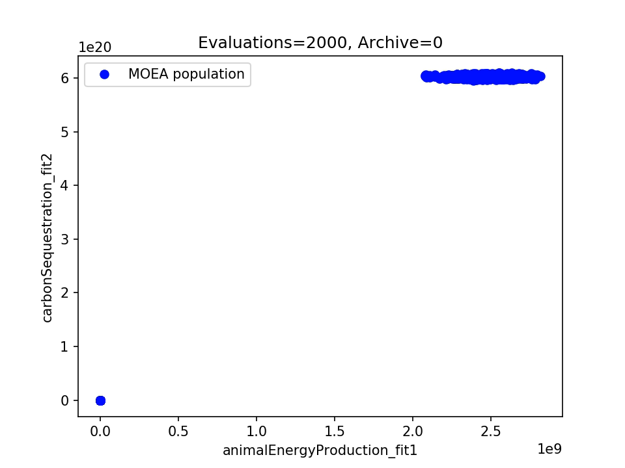

Slide 24
NSGA-II (Non-Sorting Genetic Algorithm II)
Crowding can be an issue
Too many points too close together on the PF
Not really interesting…
Fitness 2
Fitness 1

Slide 25
NSGA-II (Non-Sorting Genetic Algorithm II)
Crowding can be an issue
Ideally, you would like to explore the PF
Distribute points “evenly” on the PF
Fitness 2
Fitness 1

Slide 26
NSGA-II (Non-Sorting Genetic Algorithm II)
Crowding distance
Value associated to individuals
Used to select for reproduction/survival
This individual is not very interesting
Fitness 2
We want to explore more THIS part of the PF
Fitness 1

Slide 27
NSGA-II (Non-Sorting Genetic Algorithm II)
Crowding distance
Value associated to individuals
Used to select for reproduction/survival
Fitness 2
Fitness 1

Slide 28
NSGA-II (Non-Sorting Genetic Algorithm II)
Crowding distance
Value associated to individuals
Used to select for reproduction/survival
Fitness 2
∞
Fitness 1
Notes:
We want to keep them in the population; and generate their “children”, mutated individuals, because it is likely they will have similar performance in the Pareto space.

Slide 29
NSGA-II (Non-Sorting Genetic Algorithm II)
NSGA-II (Non-Sorting Genetic Algorithm II)
Crowding distance is a volume for 3 objectives, hypervolume for 4+ objectives
For 2 or 3 objectives, it works really well
Limitations
The more objectives, the less effective
In 10+ dimensions, all points have similar crowding distances

Slide 30
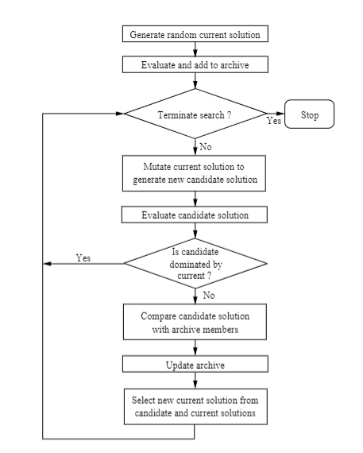
Pareto-Archived Evolution Strategy (PAES)
(1+1)-ES
Evolution Strategy with µ=1, λ=1
Uses mutation, only
Algorithm
Archive has max size
Archive is recomputed every time new candidate is added

Slide 31
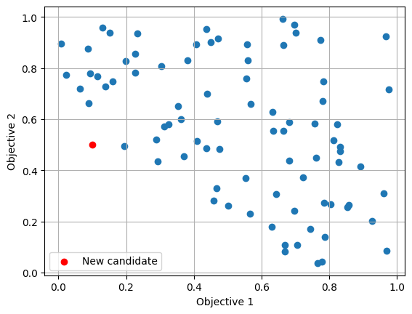
Pareto-Archived Evolution Strategy (PAES)
What about crowding?
PAES maintains a grid in objective space
Count how many candidates in same square
Grid size is a (hyper-) parameter (!)
So is the size of the archive

Slide 32
MOEA/D
«D» for «Decomposition»
Take the multi-objective problem
Convert it into N single-objective problems
Solve the problems in parallel
How to decompose the MOO problem?
Weighted sum, change weights
Tchebycheff approach
Boundary intersection

Slide 33
MOEA/D
Tchebycheff approach
Set reference points in objective space
Try to get as close as possible to the points
Objective: minimize distance to reference point(s)

Slide 34
Evaluation of MOEAs
How to evaluate different runs?
For single-objective optimization, best individual
Here we might have different Pareto fronts
We don’t know where the true front is
We can compute the hypervolume of the current Pareto front, using a reference point

Slide 35
Evaluation of MOEAs

Slide 36
Evaluation of MOEAs

Slide 37
Evaluation of MOEAs
Reference point
Reference point
B
A
A
<
B
?

Slide 38
MANY-objective optimization…?
Relatively recent research topic (2016+)
What do we do for 10+ objectives?
There’s no good answer (yet)
Clever ideas
Perform dimensionality reduction (NSGA-II+PCA)
Use individuals as references (NSGA-III)

Slide 39
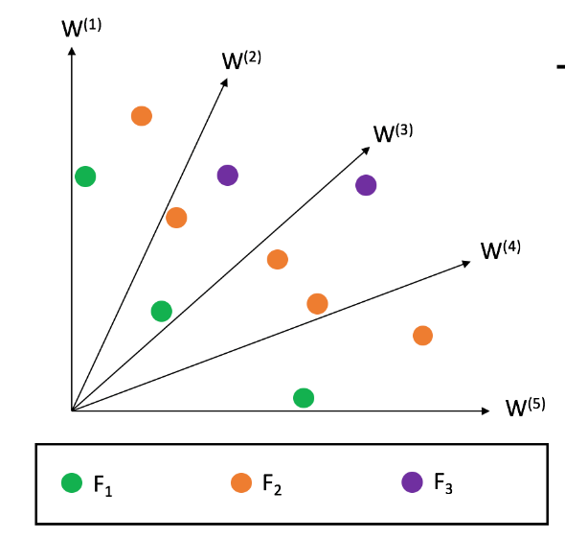
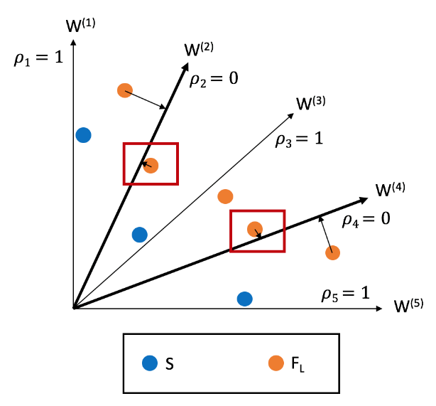
NSGA-III
Same procedure as NSGA-II for non-dominated sorting
However, user specifies reference solutions/ “directions”
When candidate solutions need to be killed in a front
…start by keeping at least one per reference direction
The closest to the reference vector

Slide 40
Alternatives to MOEAs?
If all your objective functions are linear or quadratic
Linear programming or quadratic programming
Aggregate objectives in weighted sum, vary weights
Similar to MOEA/D
Guarantees finding optimal trade-offs

Slide 41


Questions?
Bibliography - Deb, Multi-objective Optimization using Evolutionary Algorithms, 2011 - Deb & Jain, An Evolutionary Many-Objective Optimization Algorithm Using Reference-Point-Based Nondominated Sorting Approach, Part I: Solving Problems With Box Constraints, 2013
Images: unless otherwise stated, I stole them from the Internet. I hope they are not copyrighted, or that their use falls under the Fair Use clause, and if not, I am sorry. Please don’t sue me.

